Slide 1



MICETECH
Innnovation in every click

Slide 2




Investor pitch for Micetech
02
Problem
Solution
Company Overview
Business Model
market Opportunity
Competitive advantage
Financial Projection
Market strategy
why invest in Micetech

Slide 3
03
The Problem
Current Issues in the Market
Ergonomics
Customization
Precision
Many mice are uncomfortable for long hours, causing wrist strain and fatigue.
Few products offer flexibility in settings for gamers or professionals.
Low-quality sensors that affect gaming and work efficiency.

Slide 4
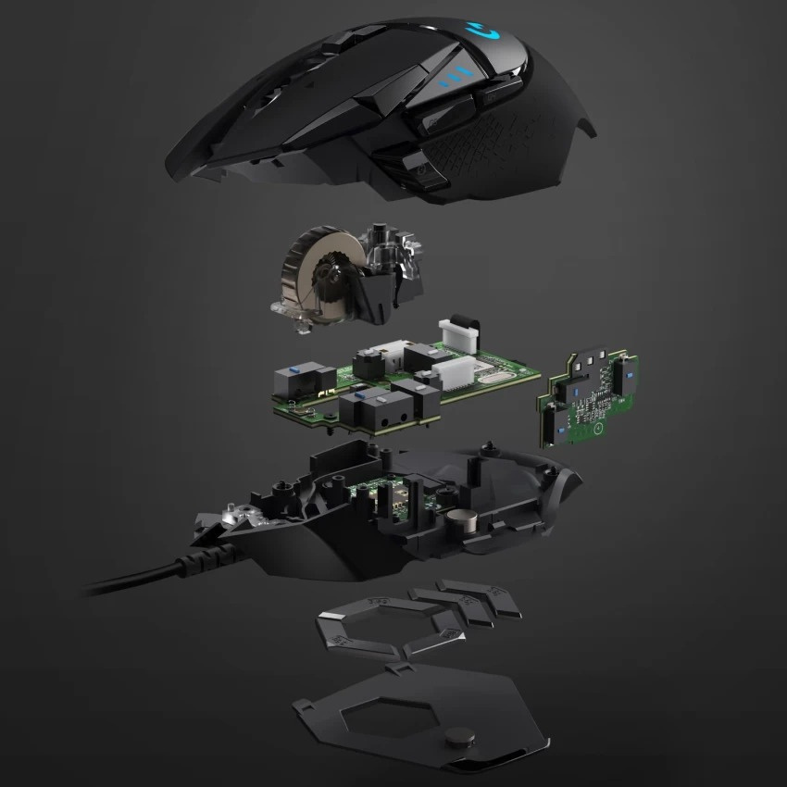
Our Solution
04
Ergonomic Design
Comfort for long sessions, with options for different hand sizes.
Precision Sensors
Adjustable DPI from 400 to 16,000 for pixel-perfect accuracy.
SolCustomizable Featuresution
Fully programmable buttons, RGB lighting, and profiles for gaming and productivity

Slide 5

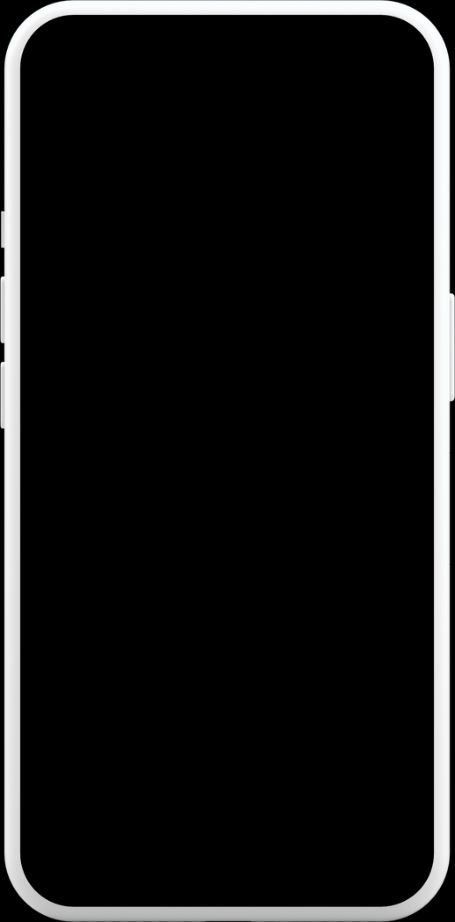
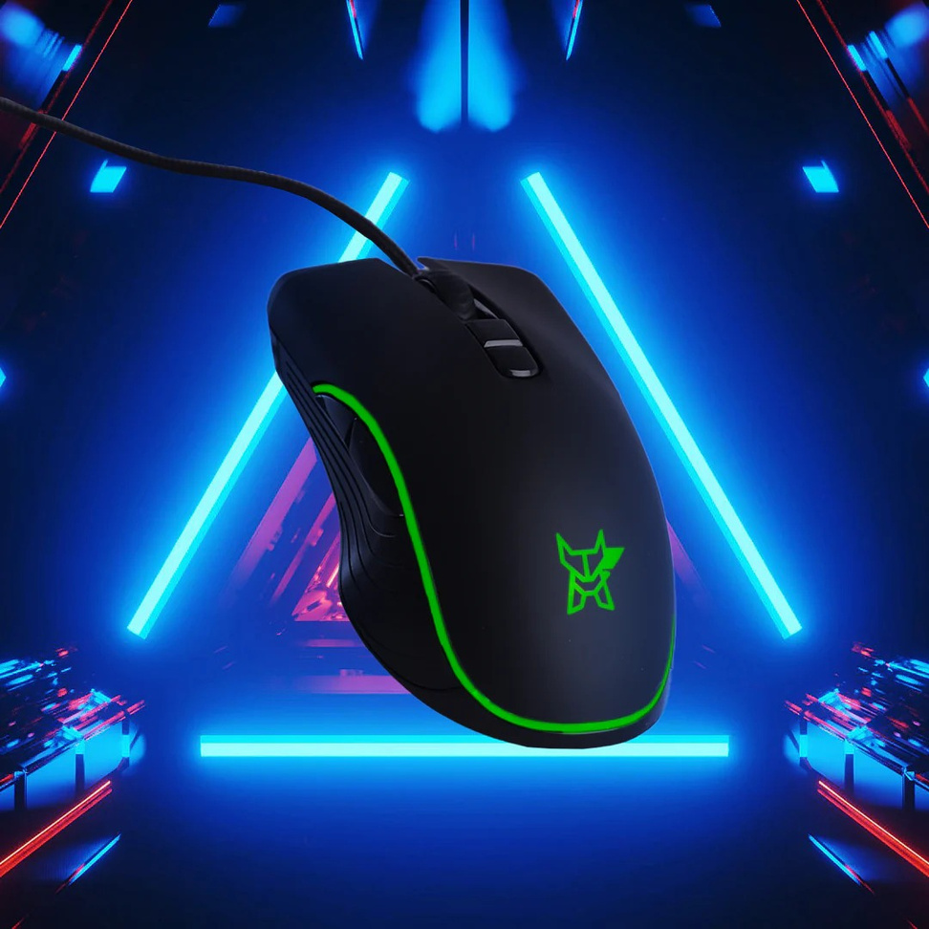
Company Overview
Micetech:
A leading innovator in precision, performance, and ergonomic mice for gamers, coders, and professionals.
To create the most reliable, comfortable, and performance-enhancing mice for all users.
Mission:
Vision:
To become the market leader in both gaming and professional accessories, delivering groundbreaking design and technology

Slide 6
Business Model
06
Revenue Streams:
Pricing Strategy
Subscription Option
Premium pricing for advanced features and durability.
Affordable entry-level options with core functionality.
Direct-to-consumer sales via the Micetech website.
Partnerships with online retailers (Amazon, Best Buy, etc.).
Wholesale to gaming stores and tech retailers.
Monthly subscriptions for customizable accessory packs (skins, grips, etc.).

Slide 7
Market Opportunity
Global Mouse Market:
The global market for computer peripherals is growing rapidly, with a focus on gaming and productivity.
Expected to hit $x million by [Year].
Gaming industry is expected to surpass $X billion by [Year]
Target Audience:
Gamers (Competitive and Casual)
Coders and Tech Professionals
General Productivity Users
Growth Drivers
Rise in eSports and gaming competitions.
Increase in remote work and tech adoption.
Demand for ergonomic and customizable products.

Slide 8
Competitive advantage
09
Innovative Design
Sustainability
First in the market to offer a fully customizable, ergonomic, high-performance mouse for both gaming and productivity.
Focus on eco-friendly materials and a recycling program for old devices.
Advanced Technology
Community & Support
Latest sensor technology, wireless low-latency capabilities, and ultra-durable build.
Excellent customer service and active engagement with the tech and gaming community.

Slide 9
Financial Projections
06
Revenue Forecast (Next 3-5 Years):
Year 1: $X million
Year 2: $X million
Year 3: $X million.
Gross Margin
Expected margins of X% due to premium pricing and efficient production.
Customer Acquisition Cost (CAC)
Focused on reducing CAC through optimized marketing strategies.
Break-even Point:
Expected within [X] years. body text

Slide 10
Market Strategy
Sales Channels:
Direct-to-consumer (website and e-commerce platforms).
Retail distribution (tech stores, gaming shops).
Marketing Strategy
Influencer Partnerships: Partnering with gaming influencers and tech reviewers.
Social Media Campaigns: Targeted ads and content across platforms like YouTube, Instagram, and TikTok.
Community Engagement: Sponsorships in gaming tournaments and tech conferences.
Sales Presentation | December 2020
Customer Retention
Loyalty programs and excellent post-purchase suppor

Slide 11
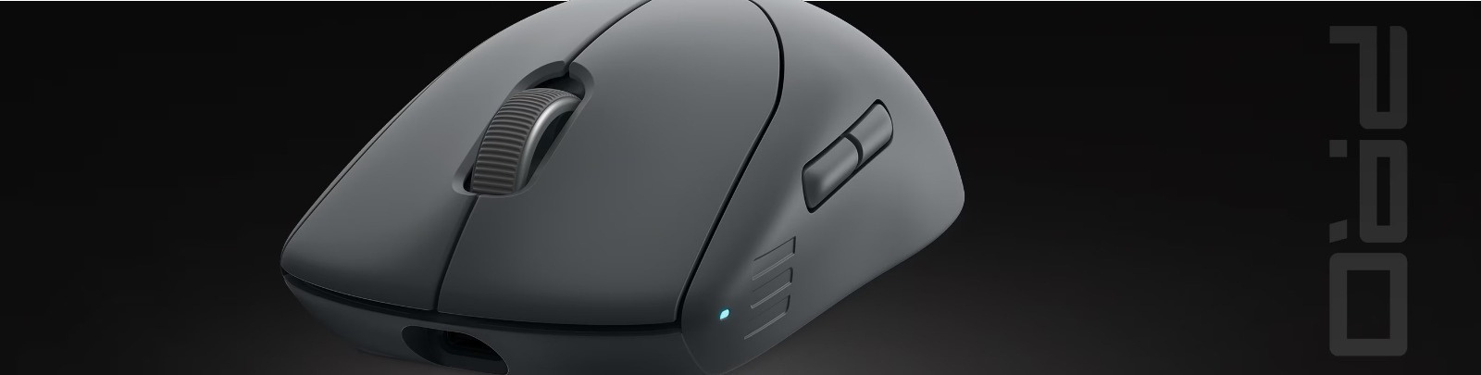
Why Invest in Micetech
A Growing Market Opportunity
The global mouse market is projected to grow to $X billion by [Year].
Increasing demand for high-performance peripherals due to eSports, remote work, and tech advancements.
Innovative Product Line
Best-in-Class Features: Ergonomics, precision sensors, customizable settings, and durable materials.
Tailored for gamers, coders, and professionals, filling a gap in the market for versatile and reliable devices.

Slide 12
14
Manisha
Student,BCA
Purnima
Sales team
Student ,BCA
Sales Presentation |

Slide 13
Contact us
15
City
Sonipat,Hatyana
Email Address
mn6372896@gmail.com
Phone Number
9468322747

